Slide 2
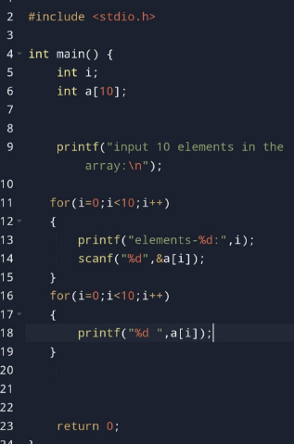
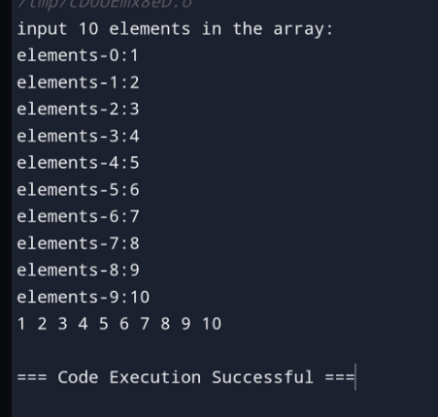
1. Write a program in C to store elements in an array and print them. Test Data : Input 10 elements in the array : element - 0 : 1 element - 1 : 1 element - 2 : 2 ....... Expected Output : Elements in array are: 1 1 2 3 4 5 6 7 8 9

Slide 3
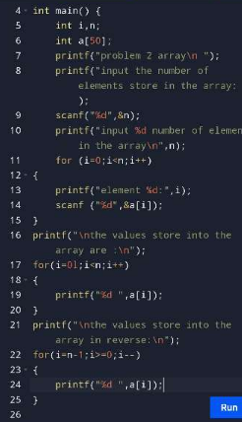
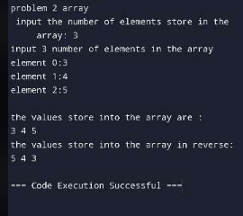
2. Write a program in C to read n number of values in an array and display them in reverse order. Test Data : Input the number of elements to store in the array :3 Input 3 number of elements in the array : element - 0 : 2 element - 1 : 5 element - 2 : 7 Expected Output : The values store into the array are : 2 5 7 The values store into the array in reverse are : 7 5 2

Slide 4
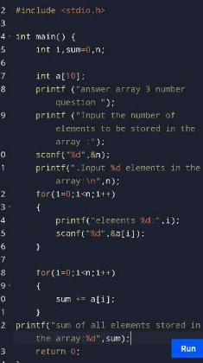
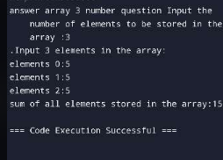
3. Write a program in C to find the sum of all elements of the array. Test Data : Input the number of elements to be stored in the array :3 Input 3 elements in the array : element - 0 : 2 element - 1 : 5 element - 2 : 8 Expected Output : Sum of all elements stored in the array is : 15

Slide 5
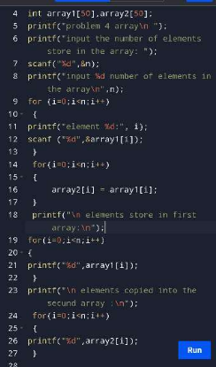
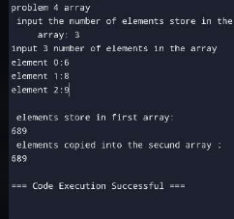
4. Write a program in C to copy the elements of one array into another array. Test Data : Input the number of elements to be stored in the array :3 Input 3 elements in the array : element - 0 : 15 element - 1 : 10 element - 2 : 12 Expected Output : The elements stored in the first array are : 15 10 12 The elements copied into the second array are : 15 10 12

Slide 6
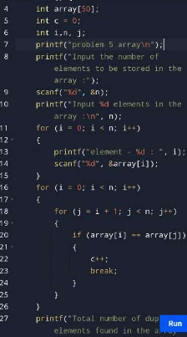
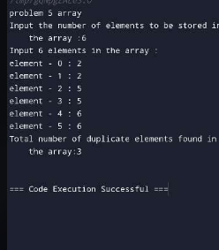
Write a program in C to count the total number of duplicate elements in an array. Test Data : Input the number of elements to be stored in the array :3 Input 3 elements in the array : element - 0 : 5 element - 1 : 1 element - 2 : 1 Expected Output : Total number of duplicate elements found in the array is : 1

Slide 7
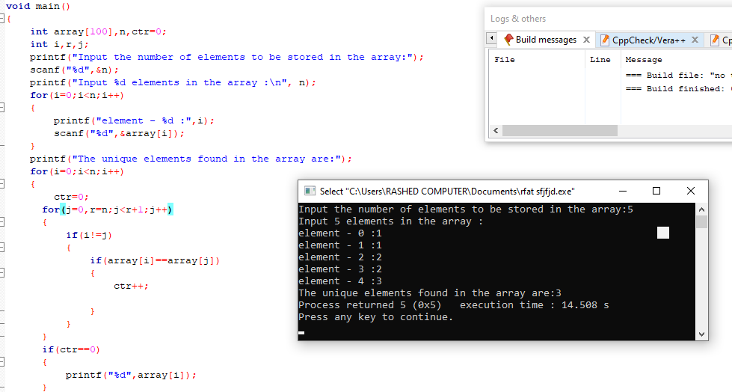
6. Write a program in C to print all unique elements in an array. Test Data : Print all unique elements of an array: ------------------------------------------ Input the number of elements to be stored in the array: 4 Input 4 elements in the array : element - 0 : 3 element - 1 : 2 element - 2 : 2 element - 3 : 5 Expected Output : The unique elements found in the array are: 3 5

Slide 8
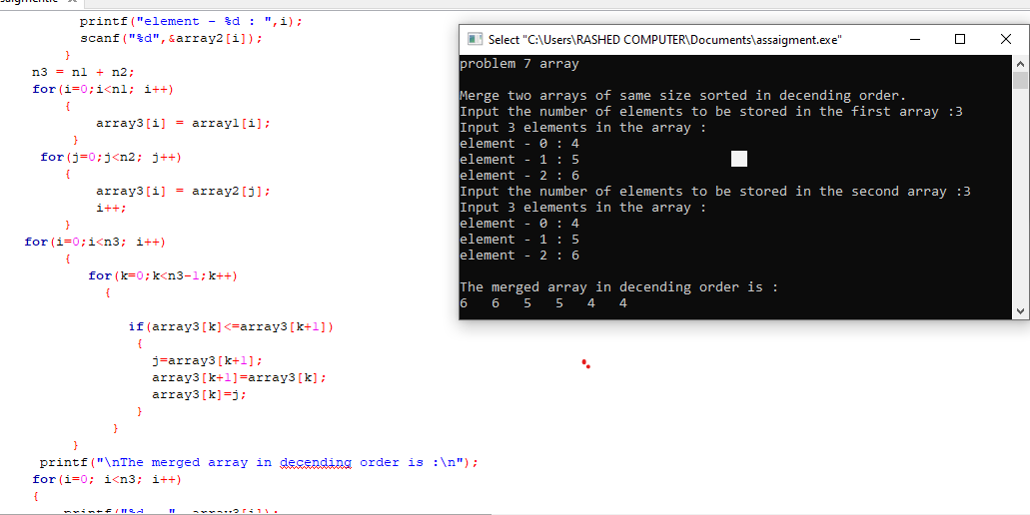
7. Write a program in C to merge two arrays of the same size sorted in descending order. Test Data : Input the number of elements to be stored in the first array :3 Input 3 elements in the array : element - 0 : 1 element - 1 : 2 element - 2 : 3 Input the number of elements to be stored in the second array :3 Input 3 elements in the array : element - 0 : 1 element - 1 : 2 element - 2 : 3 Expected Output : The merged array in decending order is : 3 3 2 2 1 1

Slide 9
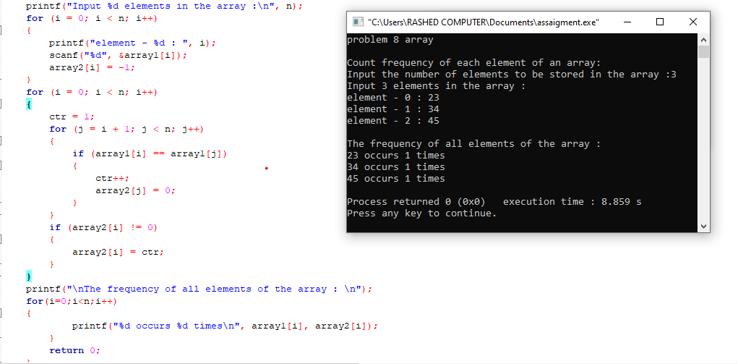
8. Write a program in C to count the frequency of each element of an array. Test Data : Input the number of elements to be stored in the array :3 Input 3 elements in the array : element - 0 : 25 element - 1 : 12 element - 2 : 43 Expected Output : The frequency of all elements of an array : 25 occurs 1 times 12 occurs 1 times 43 occurs 1 times

Slide 10
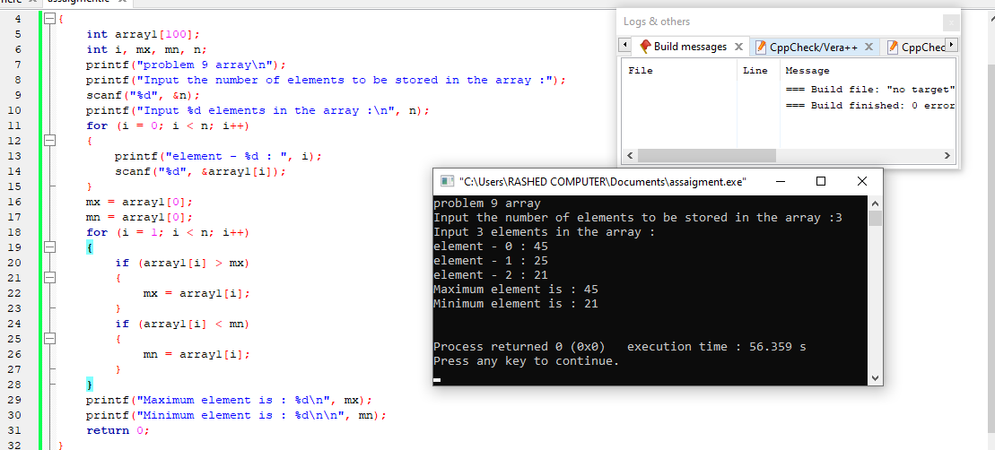
9. Write a program in C to find the maximum and minimum elements in an array. Test Data : Input the number of elements to be stored in the array :3 Input 3 elements in the array : element - 0 : 45 element - 1 : 25 element - 2 : 21 Expected Output : Maximum element is : 45 Minimum element is : 21

Slide 11
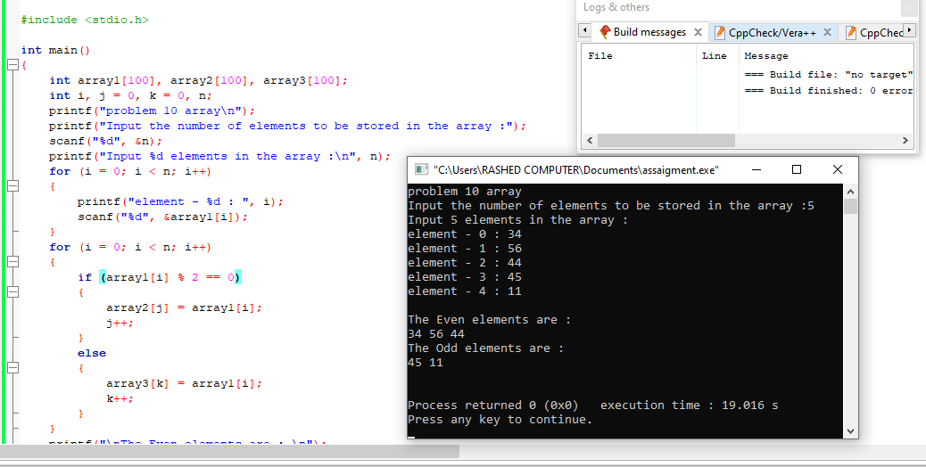
10. Write a program in C to separate odd and even integers into separate arrays. Test Data : Input the number of elements to be stored in the array :5 Input 5 elements in the array : element - 0 : 25 element - 1 : 47 element - 2 : 42 element - 3 : 56 element - 4 : 32 Expected Output : The Even elements are : 42 56 32 The Odd elements are : 25 47

